Slide 1
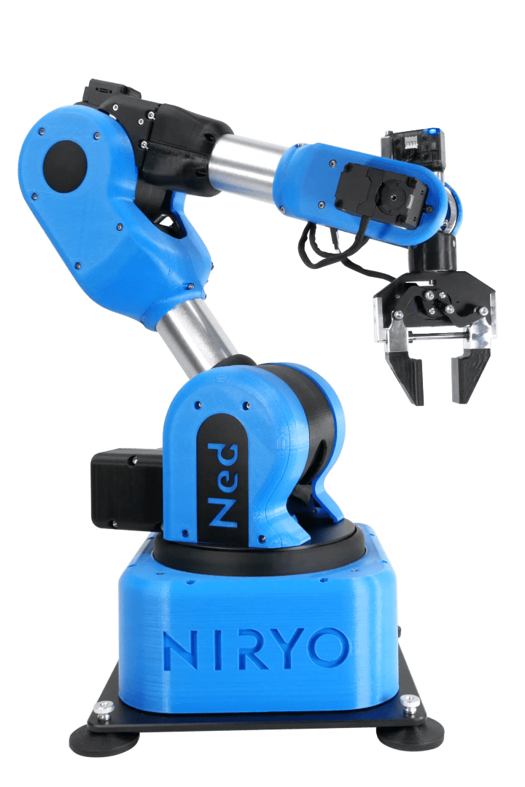


Flipkart Grid 5.0
AI & Robotics Hackathon
Robotics Arm Using
Artificial Intelligence and Computer Vision
Robotics arm with AI and computer vision have exponentially changed the manufacturing industry. This presentation will provide an overview of this groundbreaking technology and its practical use.
Presented by :-
Amarnath Jejurkar
Ankit Kamble

Slide 2
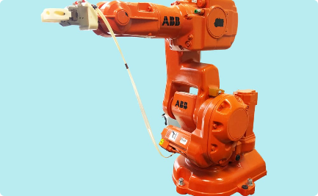
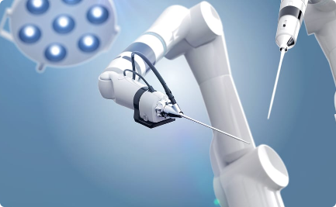
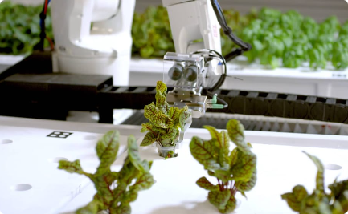
Introduction to Robotics Arm
Industrial Applications
Medical Applications
Agricultural Applications
Manufacturing, assembly, and inspection of products can be achieved with precise and accurate movements of robotics arm.
Robotics arm can help in minimally invasive surgeries and procedures, reducing trauma to the patient.
Robotics arm can be used in farms to replace manual labor and improve efficiency in crop production.

Slide 3
Overview of AI and Computer Vision
Definition
Applications
Advantages
Artificial intelligence (AI) refers to intelligence demonstrated by machines while computer vision is a branch of AI that deals with enabling machines to interpret and analyze digital images from the real world.
AI and computer vision are widely used in various applications like facial recognition, self-driving cars, and robotics arm technology.
AI and computer vision technologies have shown significant improvements in terms of precision, efficiency, and accuracy in different processes and operations, making it an ideal solution for robotics arm applications.

Slide 4
How AI and Computer Vision Improve Robotics Arm Functionality
Precision and Accuracy
Adaptability
Efficiency
AI and computer vision can enhance robotics arm capabilities by learning from its surroundings, adapting to changing environments, and identifying and correcting errors in real-time.
AI and computer vision can optimize workflows and decision-making processes, facilitating the robotics arm to perform tasks faster and more efficiently than it would with human intervention.
Using sensors, AI and computer vision can detect and analyze surrounding objects, enabling the robotics arm to execute precise and accurate movements.

Slide 5
Applications of Robotics Arm with AI and Computer Vision
Warehouse and Logistics
Robotic arms can automate the process of sorting, packing, and labeling goods in warehouses, leading to faster and more accurate processing of goods.
1
2
3
Automotive Industry
Medical Industry
Robotic arms with AI and computer vision find applications in autonomous assembly lines, quality control inspections and painting, among other things.
Robotic arms with AI and computer vision have a variety of applications in the medical industry, such as assisting in surgeries, drug discovery, and rehabilitation.

Slide 6
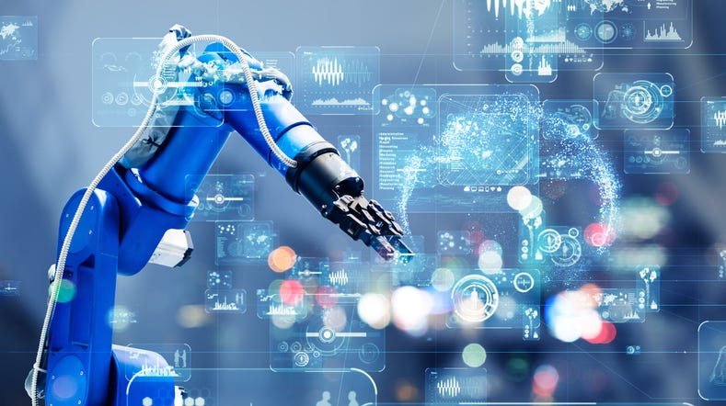
Challenges in Developing a Robotics Arm with AI and Computer Vision
1
Data Acquisition and Processing
2
Cost and Scalability
The use of advanced technology like AI and computer vision in robotics arm systems increases the production cost, making it less affordable for small-scale or medium-scale enterprises.
The accuracy and efficiency of a robotics arm with AI and computer vision depend on high-quality and large-scale data to train algorithms for optimal performance.
3
Ethical Considerations
The potential impact of AI-powered robotics arm technology on the workforce and possible ethical issues needs careful consideration before its widespread implementation in various industries.

Slide 7
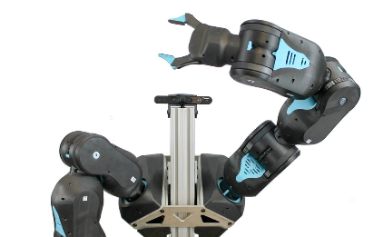
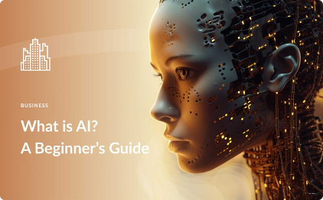
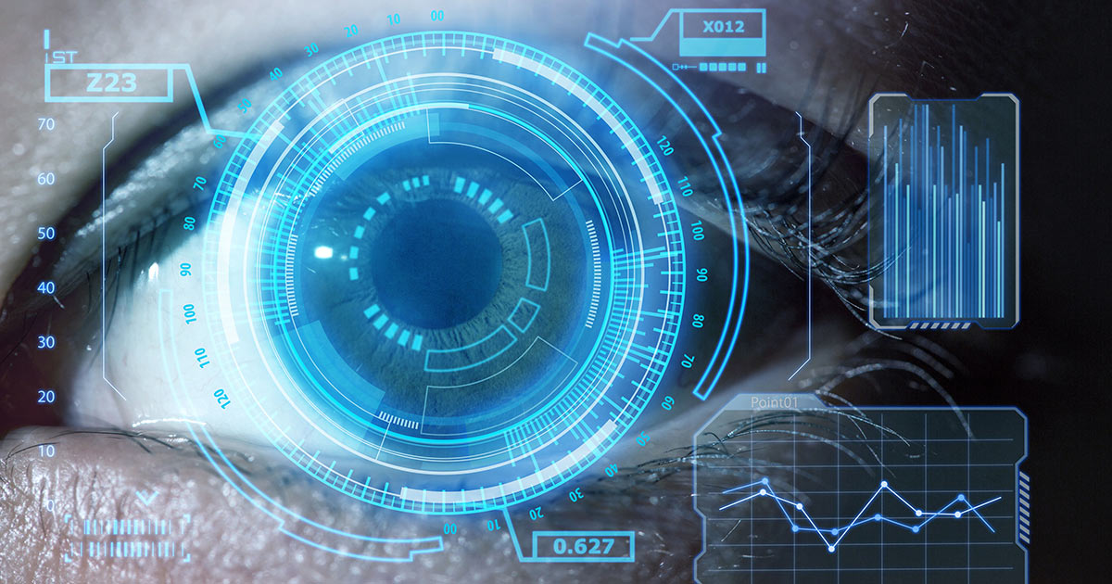
Future Developments in the Field
Advanced Robotics Arm
AI Advancements
Computer Vision Innovations
Afurther development of AI in the future will make more advanced robotics arm technology possible. The advancement in reinforcement learning, unsupervised learningand neural networks will make it possible to create more intelligent and adaptable robots.
Research is being done in robotics arm technology aiming at the development of smaller, more flexible, and lightweight robots with advanced sensory perception, screen display, and various surface adaptors.
The latest advancements in computer vision, such as 3D object reconstruction, semantic segmentation, and image style transfer will provide robotics with greater analysis and a better understanding of the environment.

Slide 8
Conclusion and Summary
The future of robotics arm
The challenges
Final words
The development of robotics arm technology with AI and computer vision is a continuous process. The next phase of manufacturing innovation will be marked by further advancements in technology and robotics, creating novel solutions and applications that will help to reshape the manufacturing industry and our society as a whole.
The implementation of robotics arm technology with AI and computer vision also poses some challenges that need to be addressed to safeguard the ethical and economic impact of these innovations.
The integration of AI and computer vision technology in robotics arm systems has revolutionized the manufacturing industry. It's expected that they'll continue to have a significant impact on various industries in the coming years.

